Slide 1
[WIP] NF Results
Last updated: 01/12/2024

Slide 2
System
Neurofilament-derived brush comprised of one or more of:
Light (156 residues) sidearm
Medium (438 residues) sidearm
Heavy (647 residues) sidearm
Response to ionic strength characterized by brush height measured through AFM
Question: role of each sidearm on overall morphology of brush and translation to biological neurofilaments

Slide 3
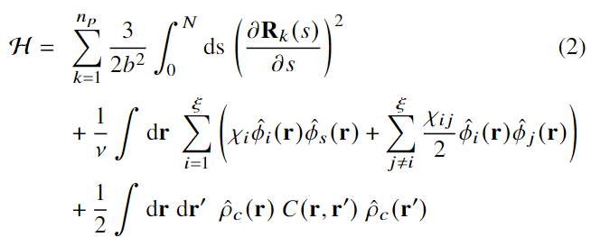
Model
Interactions
Self-consistent field theory for charged multiblock macromolecules
Coupled system of 5 algebraic equations and 2 partial differential equations
Elastic energy
Flory-Huggins (Hydrophobicity)
Electrostatics
Yokokura et al. Biomacromolecules. 2024

Slide 4
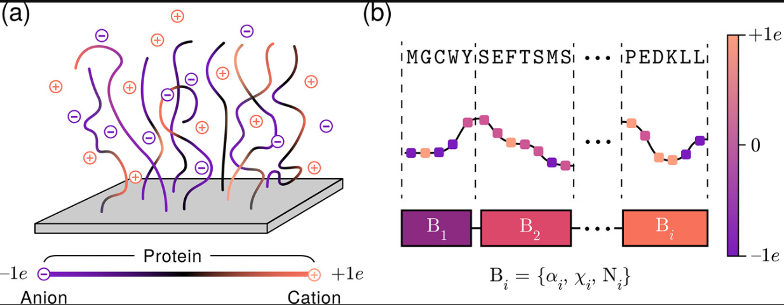
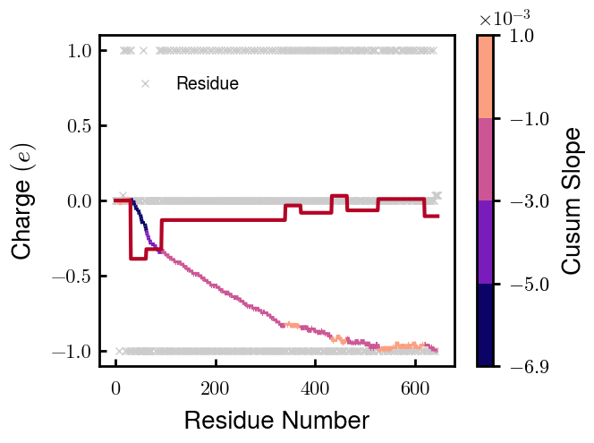
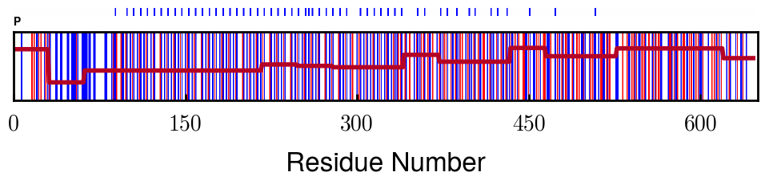
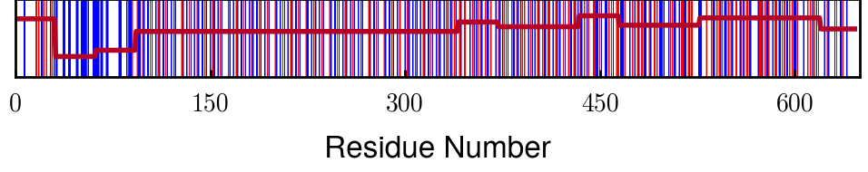
Method
Coarse-graining
Application to NF (e.g. pNFH)
Yokokura et al. Biomacromolecules. 2024

Slide 5
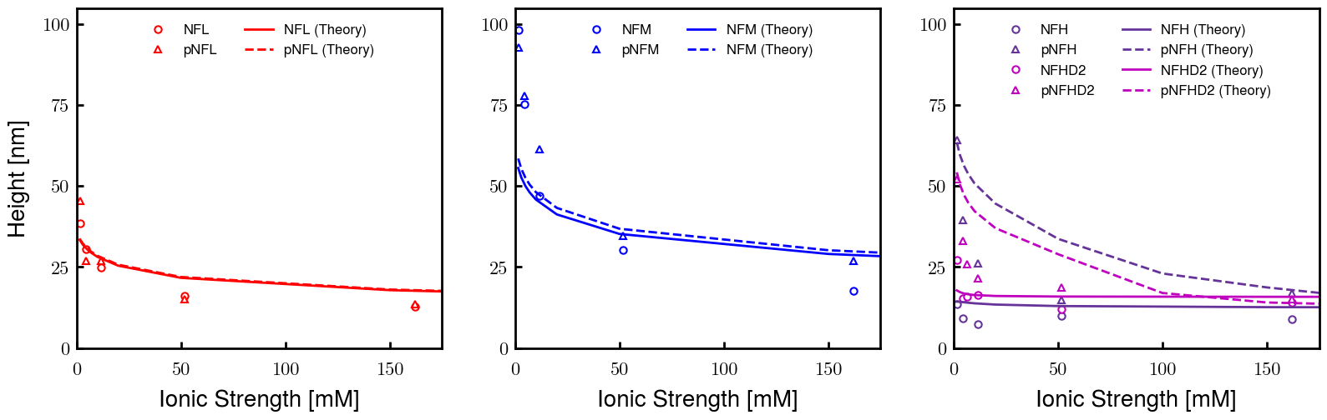
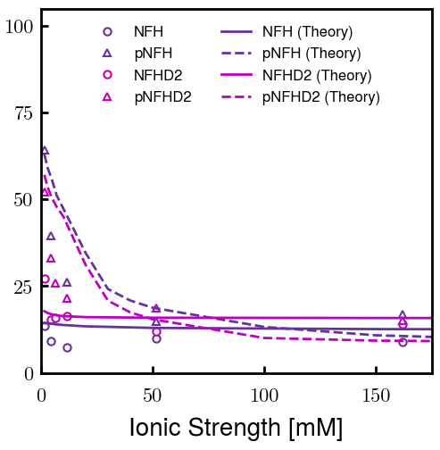
Results
pNFH option 1: b60v15
pNFH option 2: Pr040 b60v10

Slide 6
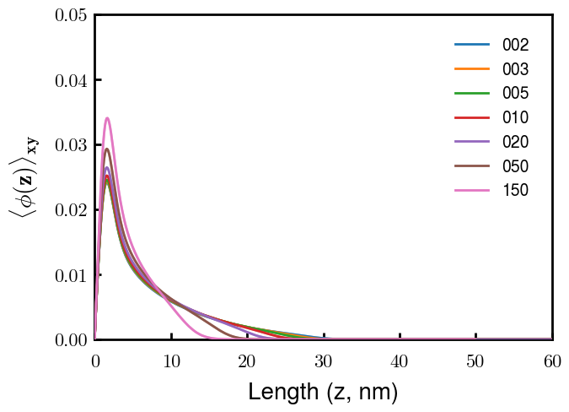
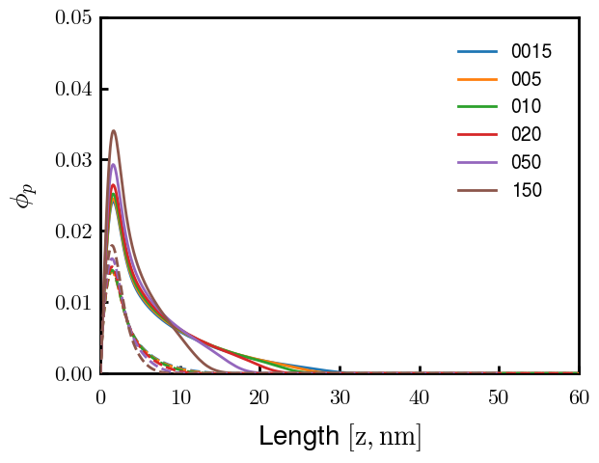
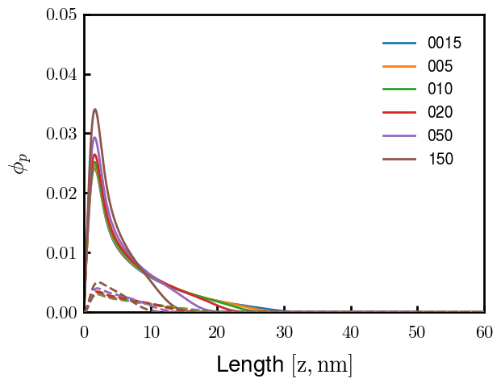
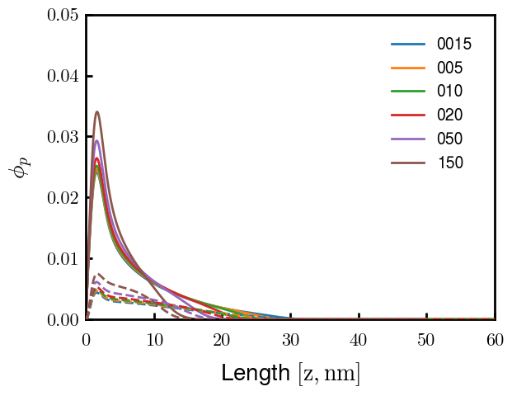
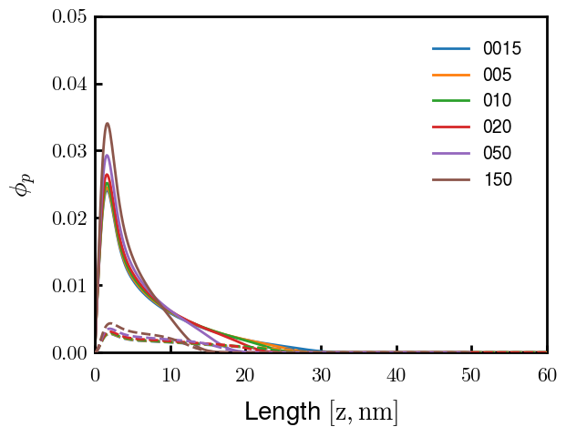
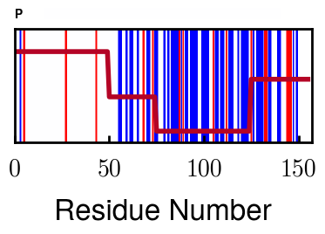
NFL
Sparse brush with 3rd block responsible for most of response to screening
1
2
3
4

Slide 7
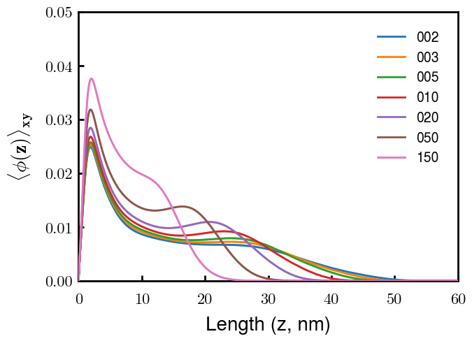
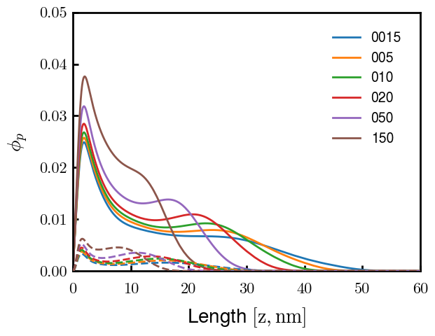
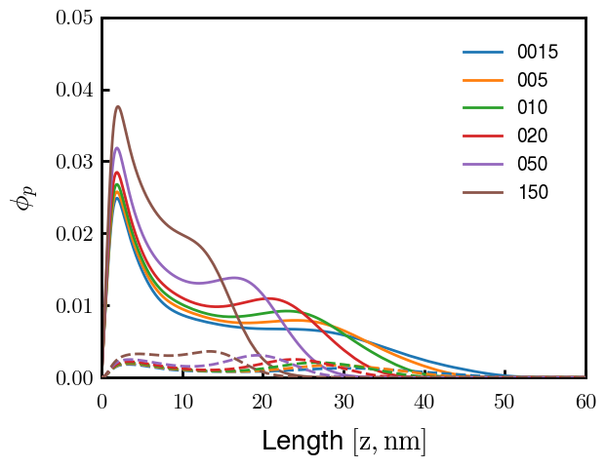
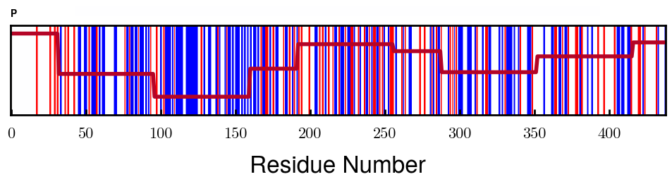
NFM
Shoulder in density distribution due to bimodal charge distribution
Fraction of chains in inner while rest in outer layer (fraction in inner layer decreases as screening decreases)
3
7

Slide 8
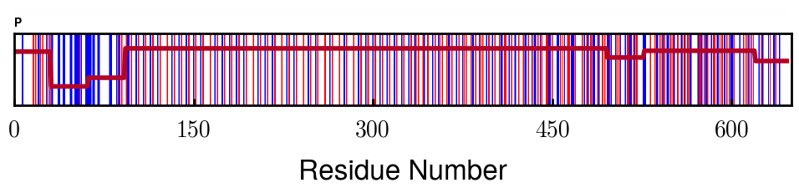
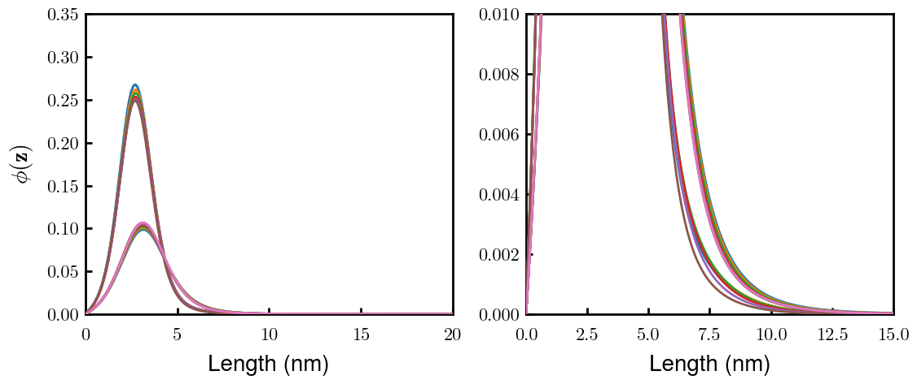
NFH(D2)
Height increase from loss of oppositely charged region
Note: Large decrease in brush volume due to lower D2 grafting density (in addition to loss of monomers): 0.03010 → 0.01854 c/nm2
Approximate D2 region
NFH
NFHD2

Slide 9
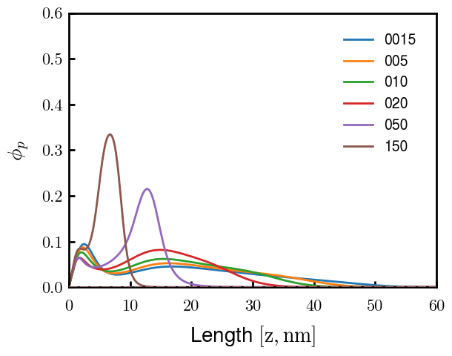
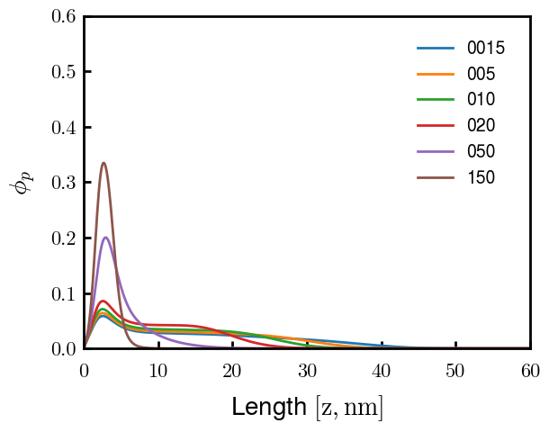
pNFH(D2) Option 1
2nd block responsible for forming second layer (looks like flower conformation previously reported for pNFH)
pNFH
pNFH_D2
Approximate D2 region

Slide 10
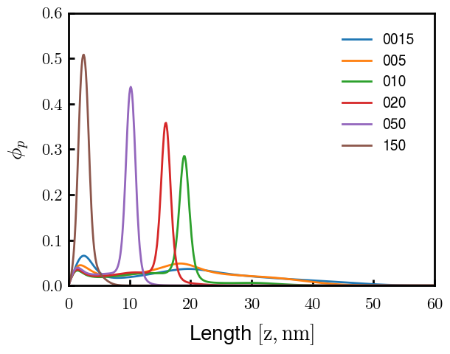
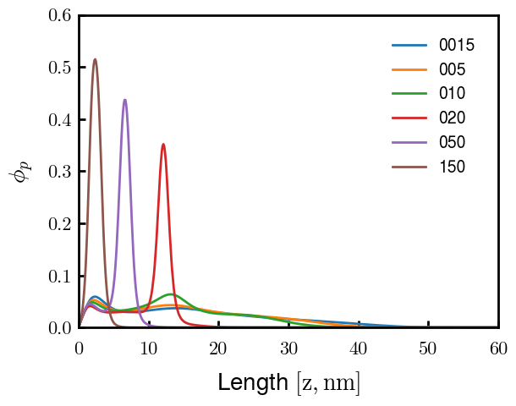
pNFH(D2) Option 2
Same conclusions as Option 1, but NFHD2 also forms second layer, just not as tall.
Approximate D2 region

Slide 11
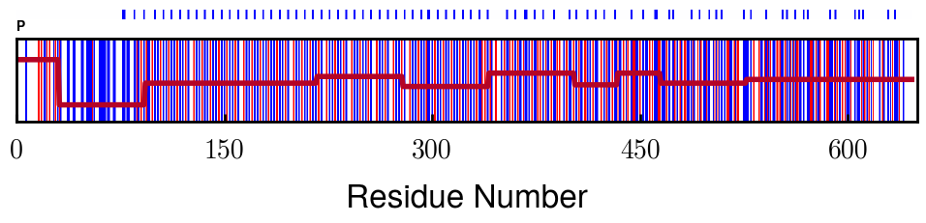
pNFH Options: Why
Option 2 changes F-H of Proline (increase) in pNFH(D2)
Originally testing F-H of Proline because Zhulina made P hydrophobic and expts reported P hydrophilic
However, changing F-H of Proline for NFH(D2) eliminates good fit with exptl values
Option 2 height response closest to exptl values in all testing
Phosphorylation may change F-H of KsP units
More rigorous method is to change F-H of phosphorylated s/t instead of P
Proline
Phos sites

